Slide 1
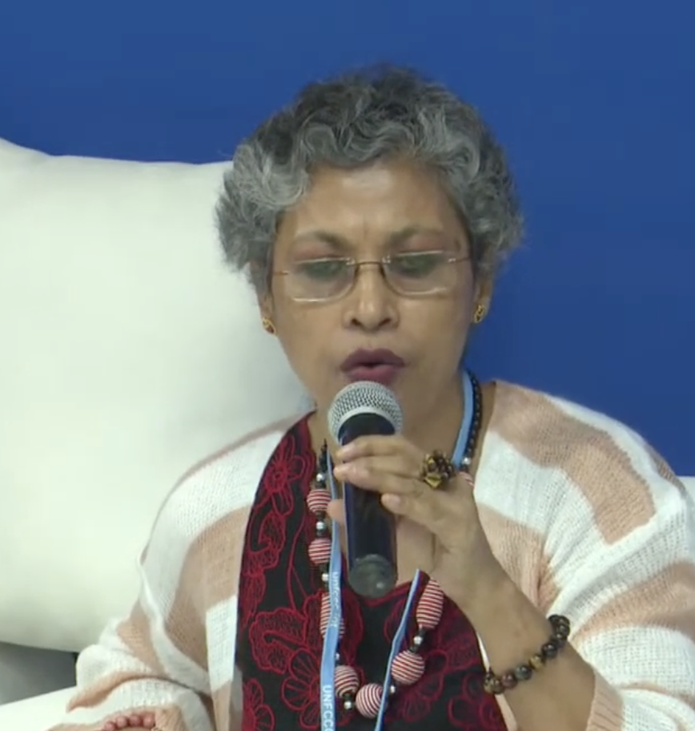
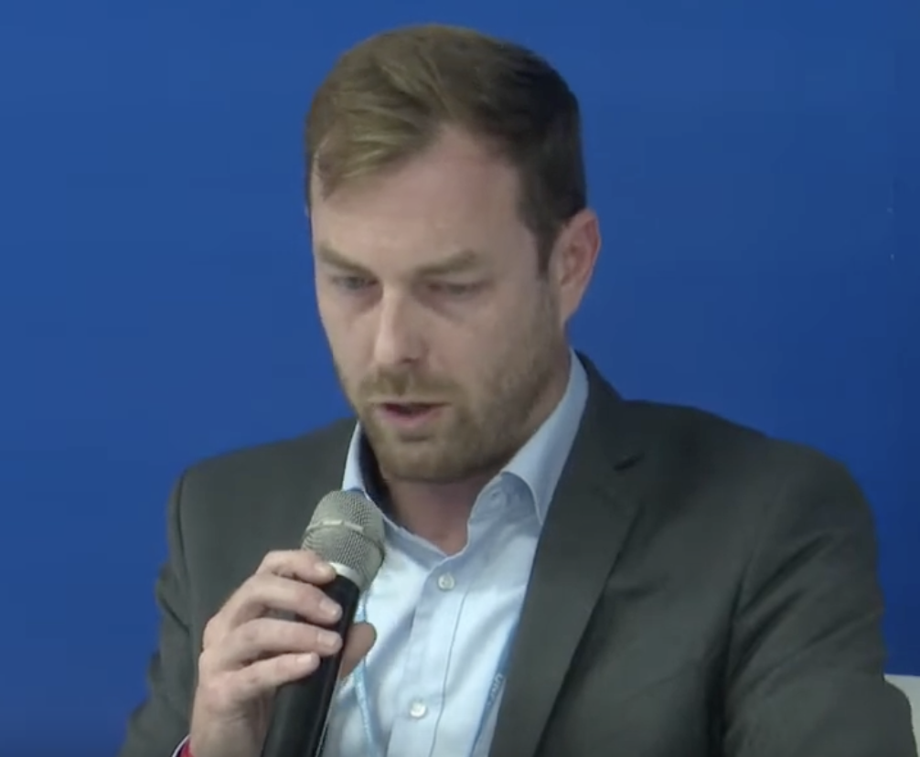
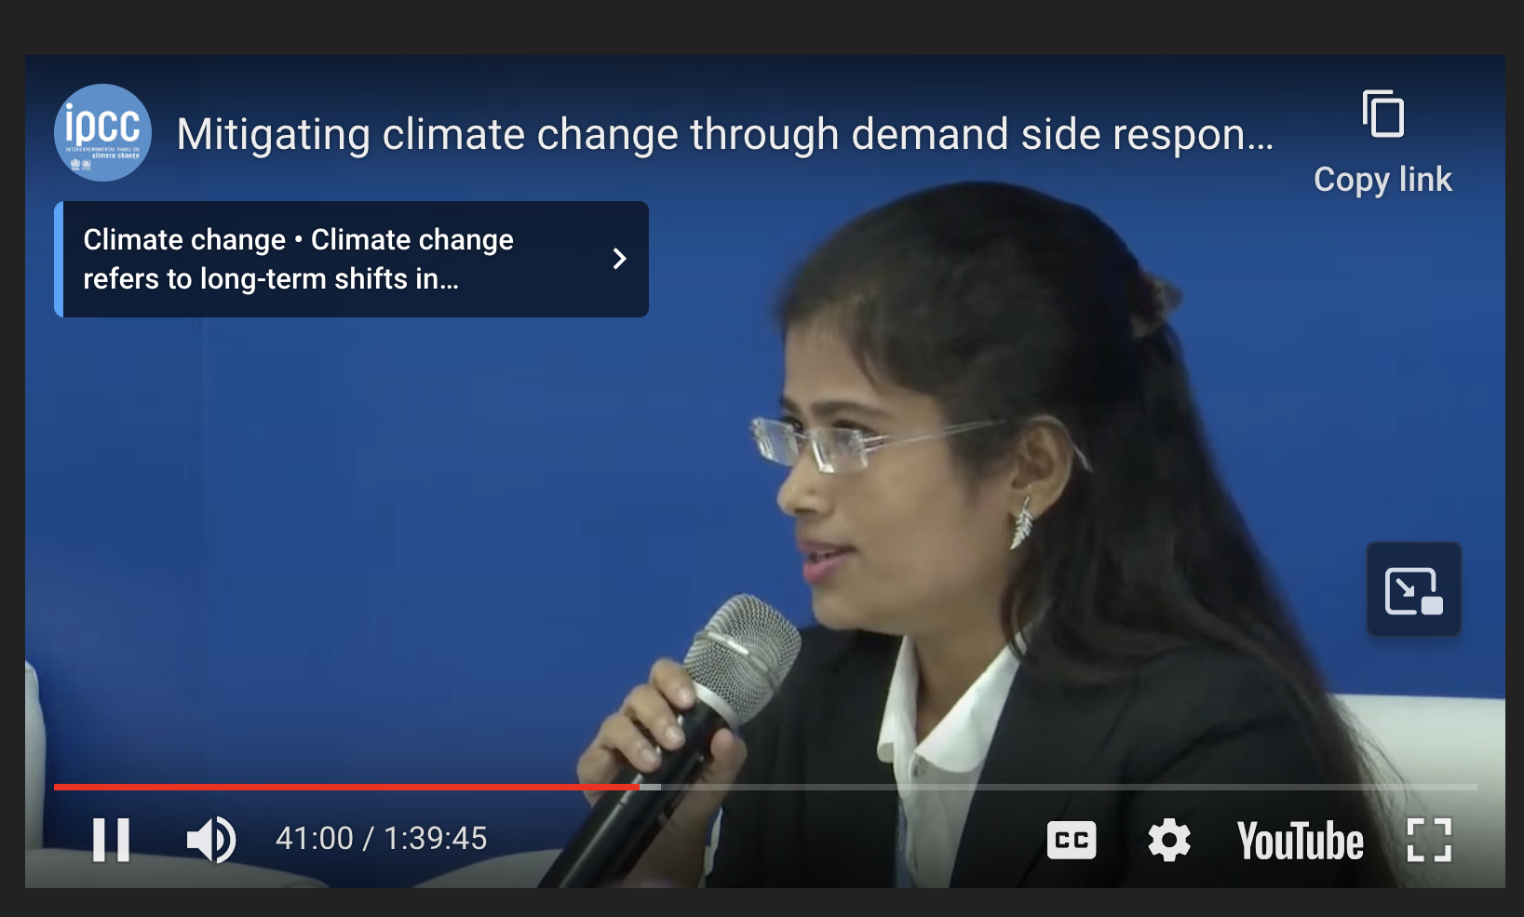

Recap: IPCC Panel Discussion on mitigating climate change through demand side reductions
Joyashree Roy, Jadavpur University
David McCollum, Oak Ridge Nat’l Lab
Shreya Some, Asia Institute of Technology
Nick Eyre, Oxford
Rowe’s replacement technique:
Replace one word or concept with another, to see how it sits.
Schrepfer’s power analysis
How does it function? (Or: What is its goal?)
Who does it benefit?
Where is the power?

Slide 2
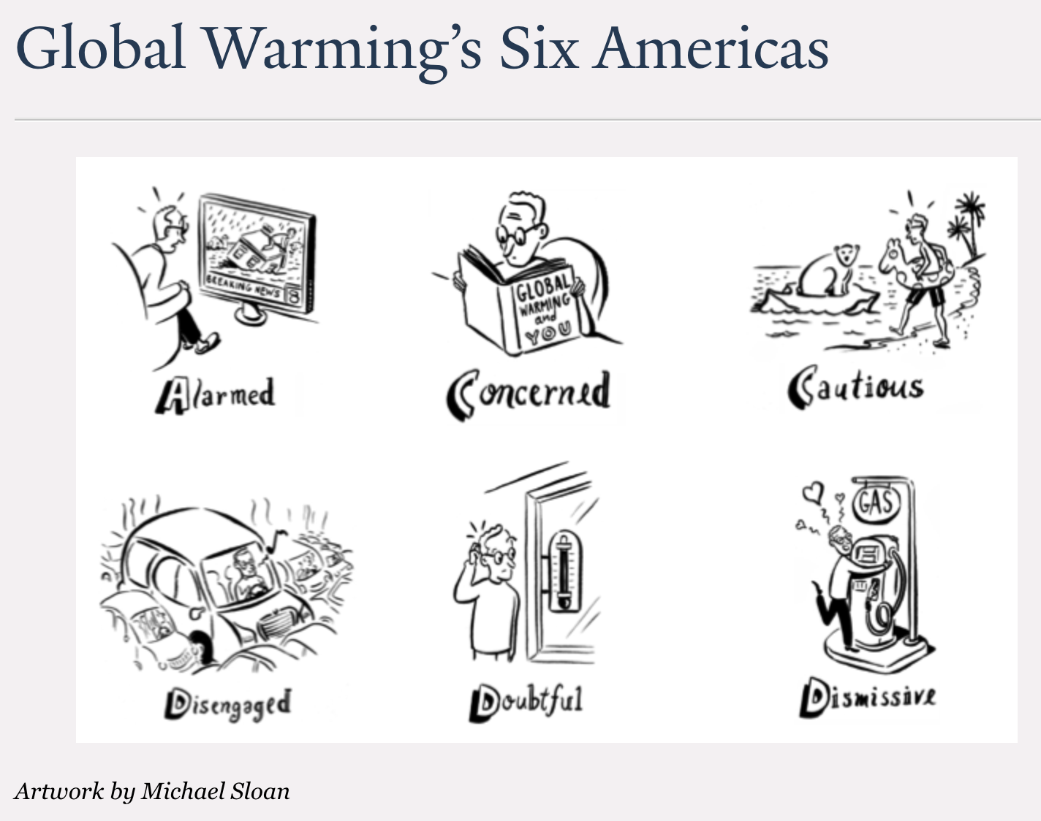
Today is about data collection
In groups of 2-3, choose somebody to start their narrative, and a scribe. It might be helpful to agree on rules, like safe space.
As narrator, describe a conversation involving climate change that left you uncertain as to how to proceed. Flesh it out with some context – which of the “Six Americas” would you say your conversation partner belongs to? Was there something left unsaid?
The scribe should record (anonymously) in our common google doc.
Rotate until everybody has had a chance to share a few conversations.
https://climatecommunication.yale.edu/about/projects/global-warmings-six-americas/

Slide 3
By Sunday night
Imagine it’s 25 years from now, and you’re living in one of the following two worlds (you get to decide which):
Warming has risen to above 2 degrees, and you’re stuck inside for most of the summer because of smoke in the air, although this is diminishing as the last of the forests burn. During power outages, there are places designated as cooling centers, which are very well-attended. There aren’t any more wild polar bears, and other species that you remember from the past are gone too. Because of faster-than-expected sea level rise, a lot of people who used to live in Florida, New Orleans and American Samoa are now crowding into housing nearby. Still, some places have it much worse: a few entire countries appear to be perennially under water.
It seems that humanity has risen to the challenges of mitigating or adapting to climate change rather well. It’s warmer, especially at night, but apart from a few inconveniences, like noisy wind turbines that keep you up at night, the world seems to have stayed pretty much the same. In fact, in many ways it’s much better – for one, the air is cleaner because people don’t drive gas-burning cars any more. People have managed to adapt to other inconveniences – like salt water intrusion into aquifers due to sea level rise, and solar powered desalinization plants – thanks to new technologies that nobody imagined 25 years ago.
You happen to find our document (created back in 2024) describing some conversations about climate change, and have a chance to reflect on one of the conversations in it. What’s different about talking about climate change now (in 2049) compared to back then? What perspectives do you wish had been in that conversation, that wasn’t? Basically, what might have made that conversation more productive?
Your reflection should be unambiguously written as if you are writing 25 years from now. To get into the mindset, for example, you could start out with something like "As I look back on the record of those conversations 25 years ago, I am really struck by the ....” I'll probably be able to tell from the context whether you are writing from Future #1 or Future #2, but if you want to tell me, that's fine -- just say so in a separate paragraph.

